Slide 1


VELTECH HIGHTECH DR. RANGARAJAN DR. SAKUNTHALA ENGINEERING COLLEGE
DEPARTMENT OF ELECTRONICS AND
COMMUNICATION ENGINEERING
A Comprehensive Application for Sign Language Alphabet and Word Recognition, Text-to-Action Conversion for Learners,
Multi-Language Support, and Integrated Voice Output Functionality.
[ Paper ID: IEEE_ICSTEM24_0404 ]
TEAM MEMBERS:
ANANDRAJ R (113020106001)
FRANKLIN SA (113020106008)
GANESH PRASATH K R(113020106009)
INTERNAL SUPERVISOR:
MRS.D.SHOFIAPRIYADHARSHINI
Asst.professor
DEPARTMENT OF ECE
VEL TECH HIGH TECH DR. RANGARAJAN DR. SAKUNTHALA ENGINEERING COLLEGE

Slide 2
ABSTRACT
The Comprehensive Application for Sign Language Alphabet and Word Recognition is an innovative tool that offers a wide range of features to assist learners.
It includes a sign language alphabet and word recognition system, allowing users to easily learn and practice sign language. The application also features a unique text-to-action conversion capability, which enables learners to convert written text into corresponding sign language actions.
Multi-language support is another valuable aspect of the application, ensuring that users can learn sign language in their preferred language.
Additionally, the integrated voice output functionality provides audio feedback, enhancing the learning experience.

Slide 3
OBJECTIVE
The primary objective of this project is to develop an inclusive and efficient application that bridges communication gaps for individuals learning and utilizing sign language.
Through the integration of advanced technologies such as computer vision and machine learning, the aim is to create a system capable of accurately recognizing and translating sign language alphabets and words in real-time. This application strives to offer a seamless learning experience by providing text-to-action conversion, enabling users to understand the corresponding gestures and actions associated with signs.
Furthermore, the objective is to ensure versatility by supporting multiple languages, catering to diverse linguistic backgrounds and fostering broader accessibility.

Slide 4
INTRODUCTION
The Comprehensive Application for Sign Language Alphabet and Word Recognition is an advanced tool designed to assist learners in improving their sign language skills. With its state-of-the-art recognition technology, the application accurately detects signs and translates them into written words.
Moreover, it features a unique Text-to-Action conversion function that enables learners to understand and perform specific sign language actions. The application also offers multi-language support, allowing users to explore various sign language systems worldwide.
Additionally, its integrated voice output functionality provides users with the option to hear the translated text, enhancing their learning experience.

Slide 5
EXISTING SYSTEM
The current state of sign language learning and communication tools faces several limitations. Existing systems often lack robustness in accurately recognizing and interpreting sign language gestures and alphabets in real-time. Many available applications struggle with limited language support, restricting accessibility for users from diverse linguistic backgrounds.
Additionally, the integration of voice output functionality in these systems is often minimal or absent, hindering auditory reinforcement for users, especially those with varied learning preferences.
Overall, the present systems exhibit a gap in inclusivity, proficiency, and accessibility for individuals learning and using sign language. There is a pressing need for an enhanced and comprehensive system that addresses these shortcomings, offering accurate recognition, multilingual support, seamless text-to-action conversion, and integrated voice output functionality for an improved and inclusive learning experience in sign language.

Slide 6
PROPOSED SYSTEM
The proposed system aims to provide a comprehensive application for sign language alphabet and word recognition. It will utilize advanced computer vision techniques to track and interpret hand gestures, allowing users to communicate using sign language.
Additionally, the system will feature a text-to-action conversion capability, which will convert written words into corresponding sign language gestures, aiding learners in practicing and mastering sign language.
Furthermore, the system will support multiple languages, enabling users to switch between different sign language alphabets and words. Lastly, an integrated voice output functionality will be included to provide audio feedback and assist users with pronunciation and comprehension.

Slide 7
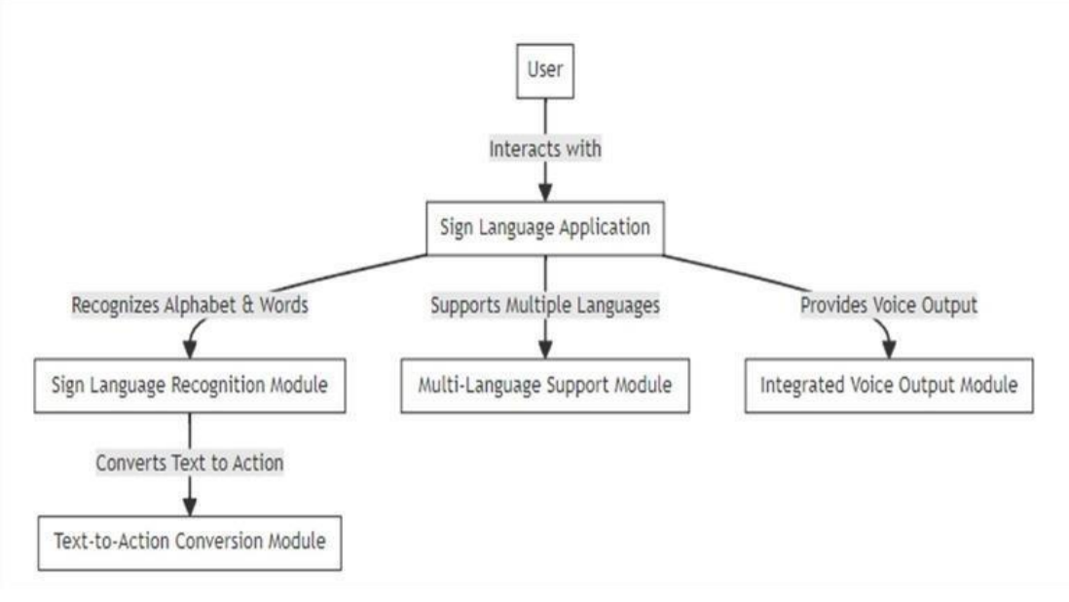
MODULE
BLOCK DIAGRAM

Slide 8
ALGORITHM
MediaPipe is a cross-platform machine learning framework that provides a variety of pre-trained models for computer vision tasks, such as face detection, hand detection, and pose estimation. When you use OpenCV with MediaPipe in Python, you are using a combination of two powerful libraries to achieve your computer vision goals.
OpenCV provides the low-level image processing and machine learning functions that MediaPipe needs to perform its tasks, while MediaPipe provides the high-level pre-trained models that make it easy to get started with computer vision.
The specific algorithm that is used when you use OpenCV with MediaPipe depends on the specific task that you are trying to accomplish. For example, if you are trying to detect faces in an image, MediaPipe will use a haar cascade classifier. Haar cascade classifiers are a type of machine learning algorithm that is specifically designed for detecting objects in images.

Slide 9
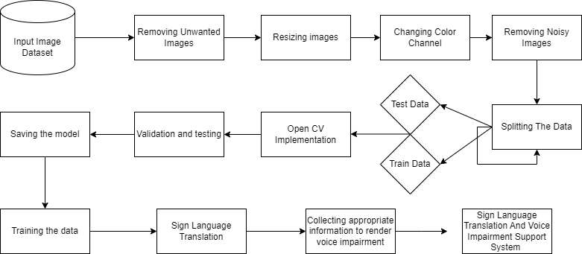
DATA FLOW DIAGRAM

Slide 10
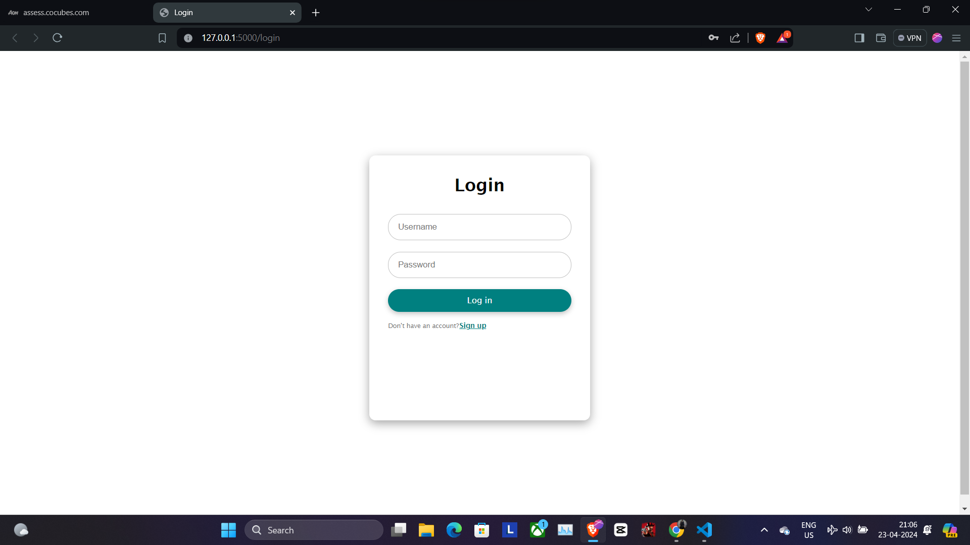

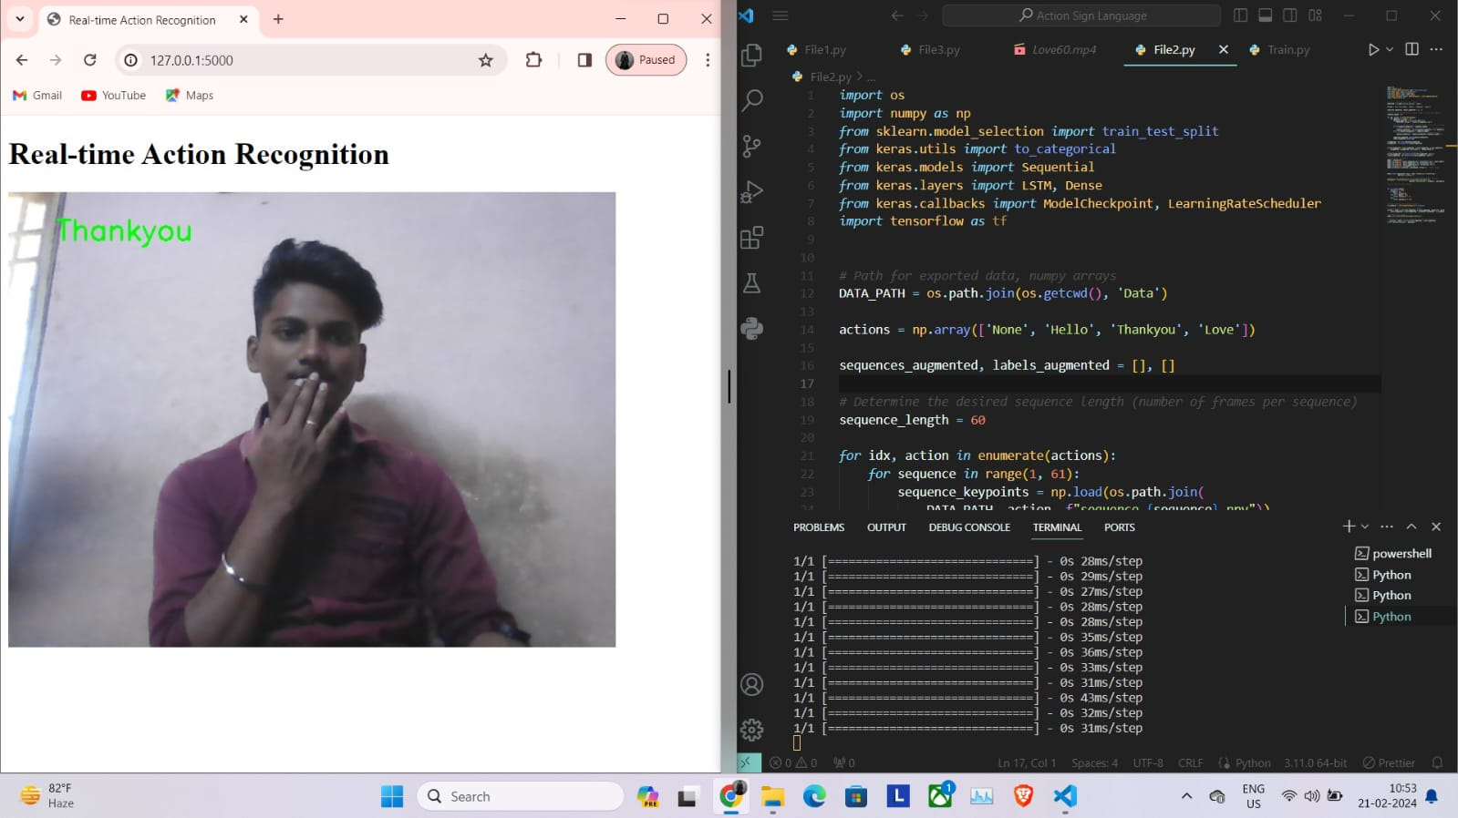
RESULT

Slide 11
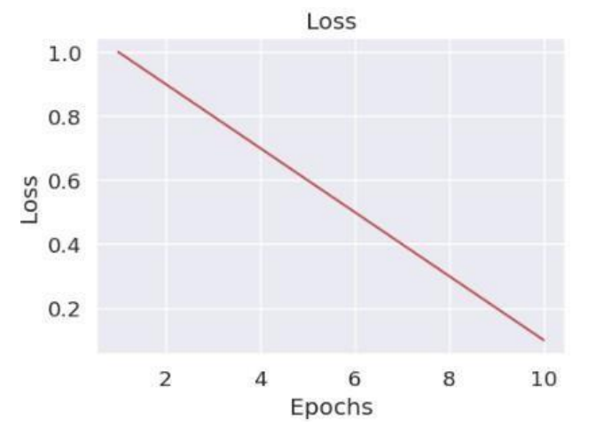
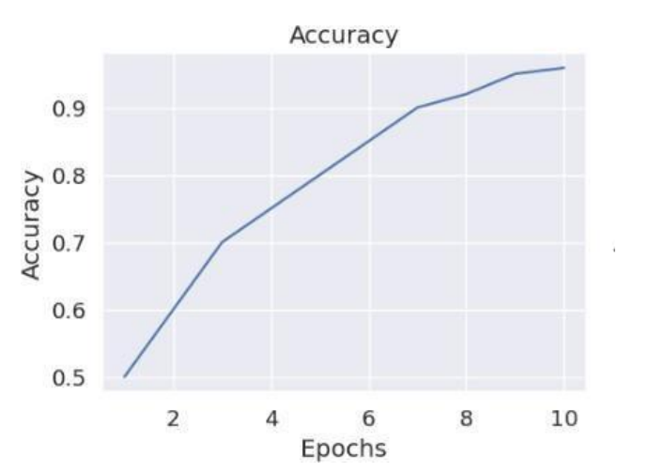
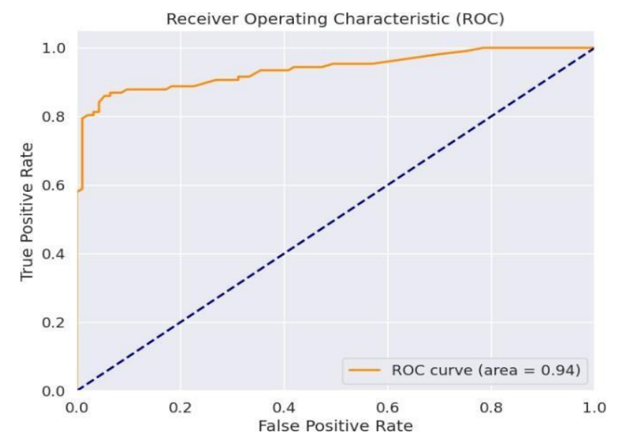
ACCURACY

Slide 12
Advantages:
The proposed system offers several advantages in terms of sign language alphabet and word recognition.
It provides a comprehensive application that can effectively recognize and interpret various sign language gestures, helping learners improve their sign language skills. Additionally, the system offers text-to-action conversion functionality, allowing learners to convert written text into corresponding sign language actions.
Another advantage is the multi-language support provided by the system, allowing learners to study sign language in multiple languages. Lastly, the integrated voice output functionality enhances the learning experience by providing spoken feedback and instructions, further facilitating the learning process.

Slide 13
APPLICATION
Communication Aids: These systems find applications in video calls, messaging apps, and virtual meetings where sign language users can interact seamlessly with others.
Education and Learning: Sign language recognition can enhance education for deaf or hard-of-hearing individuals.
Assistive Technology: Such technology assists people with hearing impairments in daily tasks, including phone class, navigation and home automation.
Health Care: It can be integrated into medical devices, appointment booking systems and patient information portals.
Robotics and Automation: Robots equipped with sign language recognition can assist deaf individuals in public spaces, offices and homes.

Slide 14
CONCLUSION:
The system for A Comprehensive Application for Sign Language Alphabet and Word Recognition, Text-to-Action Conversion for Learners, Multi-Language Support, and Integrated Voice Output Functionality, in conclusion, is a very useful tool for people who are learning sign language.
It provides a comprehensive framework that can identify and interpret words and alphabets in sign language, translating them into matching motions to improve learning.
Its multilingual support further ensures accessibility for a larger audience and enables learners to practice sign language in their own native languages.
By offering audio feedback to assist with pronunciation and comprehension, the integrated voice output capabilities enhances the user experience even further. For learners of all skill levels, this method is a valuable tool since it provides a comprehensive approach to learning sign language.

Slide 15
REFERENCES
Lee, C. K., Ng, K. K., Chen, C. H., Lau, H. C., Chung, S. Y., & Tsoi, T. (2021). American sign language recognition and training method with recurrent neural network. Expert Systems with Applications, 167, 114403.
Shin, J., Matsuoka, A., Hasan, M. A. M., & Srizon, A. Y. (2021). American sign language alphabet recognition by extracting feature from hand pose estimation. Sensors, 21(17), 5856.
Wadhawan, A., & Kumar, P. (2021). Sign language recognition systems: A decade systematic literature review. Archives of Computational Methods in Engineering, 28, 785-813.
Murali, R. S. L., Ramayya, L. D., & Santosh, V. A. (2020). Sign language recognition system using convolutional neural network and computer vision.
Sharma, S., & Kumar, K. (2021). ASL-3DCNN: American sign language recognition technique using 3-D convolutional neural networks. Multimedia Tools and Applications, 80(17), 26319-26331.

Slide 16
THANK YOU

